Slide 1

Part – I : ANALOG ELECTRONICS
CHAPTER-1: DIODES AND APPLICATONS
Module – 3: Voltage Regulators
Reference:
Robert L. Boylestad, Louis Nashelsky, Electronic Devices & Circuit Theory, 11th Edition, PHI, 2012
1

Slide 2
Module – 3: Voltage Regulators
Learning Outcomes:
At the end of this module, students will be able to:
Describe the working of Zener as voltage regulator
Discuss the IC based voltage regulator.

Slide 3
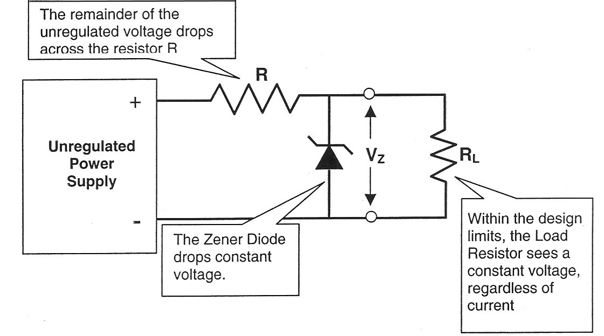
Zener voltage regulation
Notes:
Zener diodes are widely used to regulate the voltage across a circuit. When connected in parallel with a variable voltage source so that it is reverse biased, a zener diode conducts when the voltage reaches the diode's reverse breakdown voltage. From that point it keeps the voltage at that value.

Slide 4
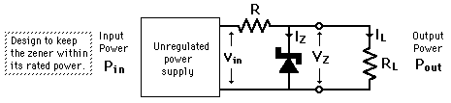
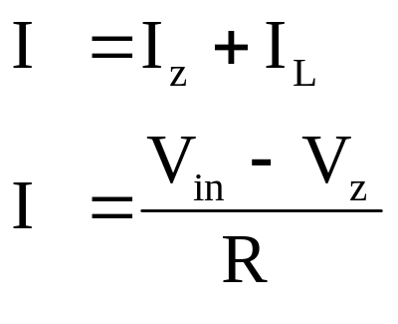
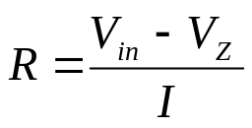
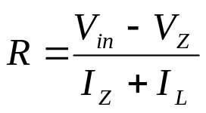
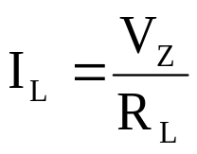
line regulation and load regulation
(i) For Line regulation, R_{L} is constant and
is also constant and V_{in} varies bet.
V_{in(min)} to V_{in(max)}

Slide 5
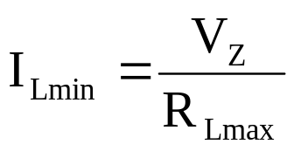
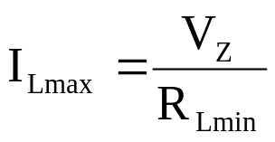
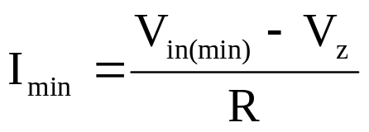
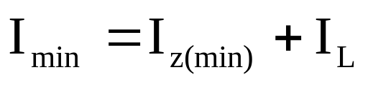

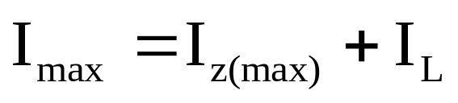
Load regulation
(ii) For Load Regulation, V_{in} is constant and R_{L} varies between R_{Lmin} and R_{Lmax} and load current is given by and
When V_{in}=V_{in(min)},and I_{L} is constant
Similarly when V_{in}=V_{in(max)} we have

Slide 6
Exercise on Zener Regulators
1. Design a Zener regulator circuit to meet following specifications:
Load voltage=8V, input voltage=30 V, Load current=0-50 mA, Iz_{min}= 5 mA, Pz= 1 watts.
Ans: R_{max}=400 Ω , R_{min}=176 Ω
2. In a Zener regulator, the input DC is 10 V ± 20%. The output requirements are 5 V, 20 mA. Given Izmin=5 mA and Izmax=80 mA. Design the Zener regulator.
Ans: R_{L}=250 Ω, V_{inmin}=8V , V_{inmax}=12 V, R_{max}=120 Ω , R_{min}=70 Ω.

Slide 7
Self test
  1. If the series resistance increases in an unloaded Zener regulator, the Zener current
  a. Decreases
  b. Stays the same
  c. Increases
  d. Equals the voltage divided by the resistance
  2. In a loaded Zener regulator, which is the largest current?
  a. Series current
  b. Zener current
  c. Load current
  d. None of these

Slide 8
IC voltage regulators
1. Fixed voltage regulator
2. Adjustable voltage regulators
Notes:
IC voltage regulators are versatile, relatively inexpensive and are available with features such as programmable output, current / voltage boosting is possible

Slide 9
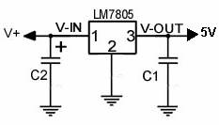
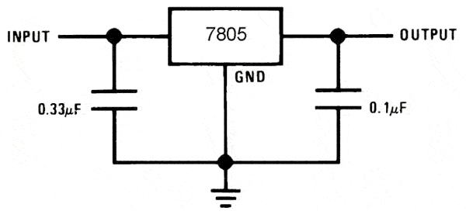
Fixed voltage regulators
IC regulator like LM117, LM317, LM338 are adjustable voltage regulators. IC 78xx and 79xx are positive and negative voltage regulator.
Notes:
78XX series are three terminal positive voltage regulators. MC7805 is a 3-terminal 1A positive voltage regulator. It is designed for a wide range of applications. These applications include on-card regulation for elimination of noise and distribution problems associated with single-point regulation. In addition, it can be used to make high current voltage regulators.

Slide 10
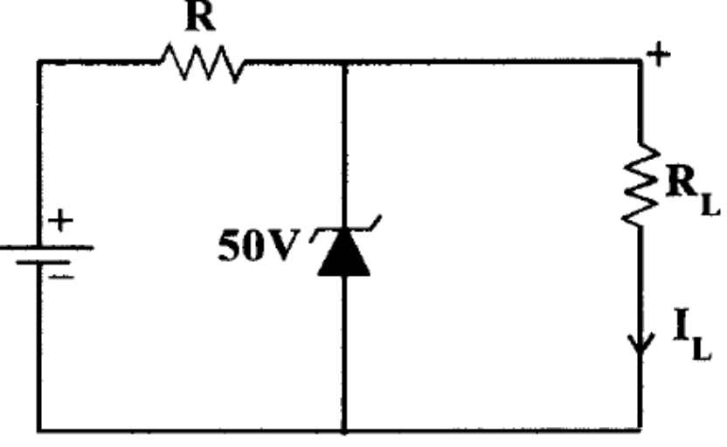
Exercise
1. (a) Consider the circuit shown below.
The Zener Diode regulates at 50V over a range of diode current from 5 mA to 40 mA. Supply voltage V = 200V. Calculate the value of R to allow voltage regulation from a load current I_{L} = 0 upto Imax; the maximum possible value of I_{L}. What is Imax? (Ans: Imax=35 mA)
(b) If R is set as in part (a) and I_{L} = 25mA, what are the limits between which V may vary without loss of regulation in the circuit?
(Ans: Vmin=162.5 V, Vmax=293.8 V )

Slide 11
Part – I : ANALOG ELECTRONICS
CHAPTER-1: DIODES AND APPLICATONS
Module – 4: Special Purpose Diodes
Reference:
Robert L. Boylestad, Louis Nashelsky, Electronic Devices & Circuit Theory, 11th Edition, PHI, 2012
1

Slide 12
Module – 4: Special purpose diodes
Learning Outcomes:
At the end of this module, students will be able to:
Explain the working of the LEDs and applications
Explain the working of the photodiode and applications
Explain the working of the opto-coupler and applications
Explain the working of the solar cells and applications

Slide 13
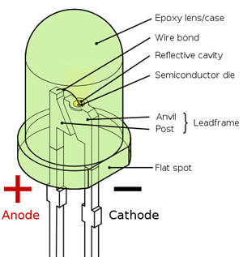
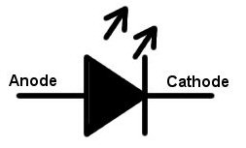
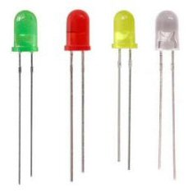
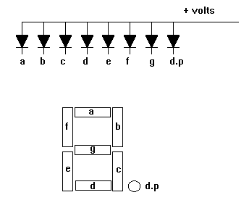
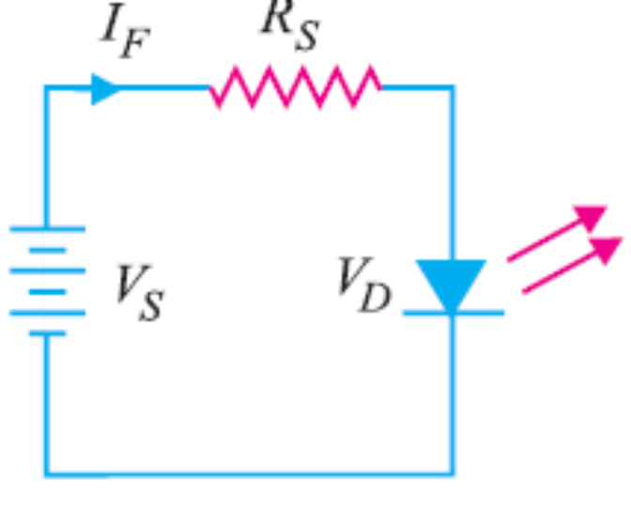
Light Emitting Diode
Electrical set-up of LED
Notes:
LEDs
Light emitting diode is a diode that emits light in visible or invisible (infrared) range when forward biased. In any P-N junction there is a recombination of holes and electrons.

Slide 14
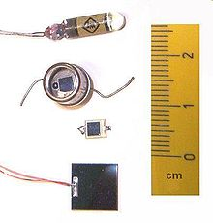

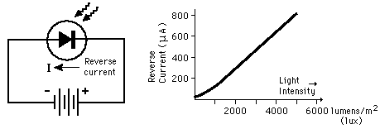
Photo Diode
[http://hyperphysics.phy-astr.gsu.edu/hbase/electronic/photdet.html]
Notes:
A photodiode is a semiconductor device that converts light into current. The current is generated when photons are absorbed in the photodiode. A small amount of current is also produced when no light is present. Photodiodes may contain optical filters, built-in lenses, and may have large or small surface areas. Photodiodes usually have a slower response time as its surface area increases. The common, traditional solar cell used to generate electric solar power is a large area photodiode.

Slide 15
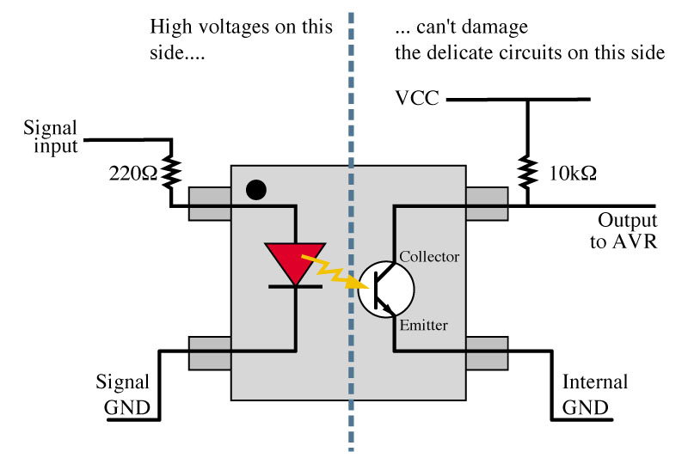
Optocoupler
Schematic of optocoupler
[http://www.ustudy.in/node/7519
Notes:
An optocoupler, also called opto-isolator, is an electronic component that transfers an electrical signal or voltage from one part of a circuit to another, or from one circuit to another, while electrically isolating the two circuits from each other.

Slide 16
1. A LED is a diode that gives off ...........when .........biased.
2.LED is manufactured using gallium arsenide gives ........... light.
3. How photo diode differs from rectifier diode?
4. The output voltage of Optoisolator depends upon.........
5.What is dark resistance of photo-diode ?
6. To display the digit 0 in a seven segment display
(a) A must be lighted
(b) F must be off
(c) G must be on
(d) all segments except G should be lighted
Self test

Slide 17
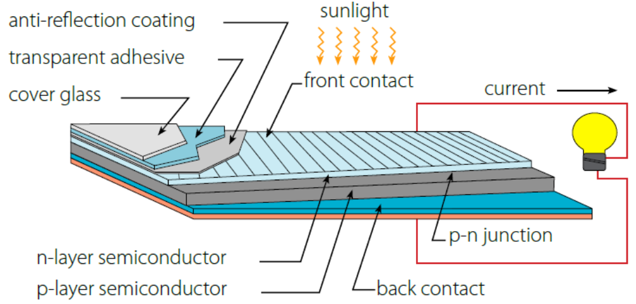
Solar cell
Structure of solar cell
[www.solarbc.ca]
Notes:
A solar cell (also called a photovoltaic cell) is an electrical device that converts the energy of light directly into electricity by the photovoltaic effect. It is a form of photoelectric cell (in that its electrical characteristics—e.g. current, voltage, or resistance—vary when light is incident upon it) which, when exposed to light, can generate and support an electric current without being attached to any external voltage source, but do require an external load for power consumption.

Slide 18
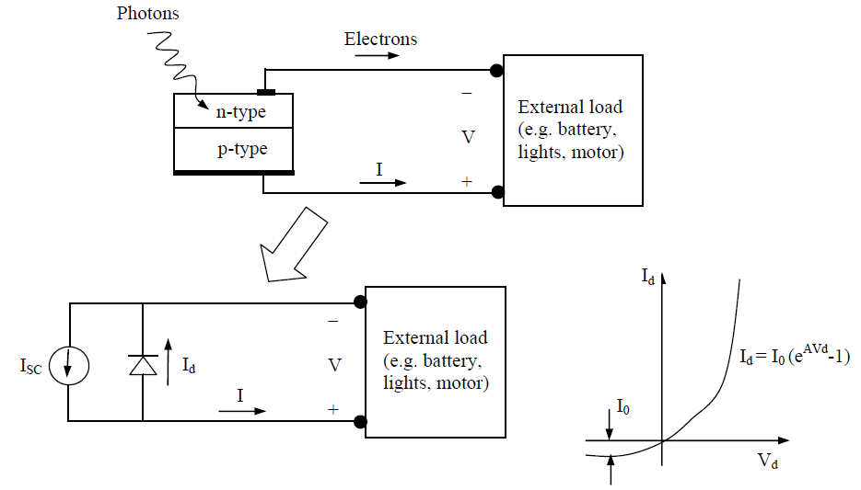
Solar cell
Equivalent circuit and I-V characteristic of a solar cell
1

Slide 19
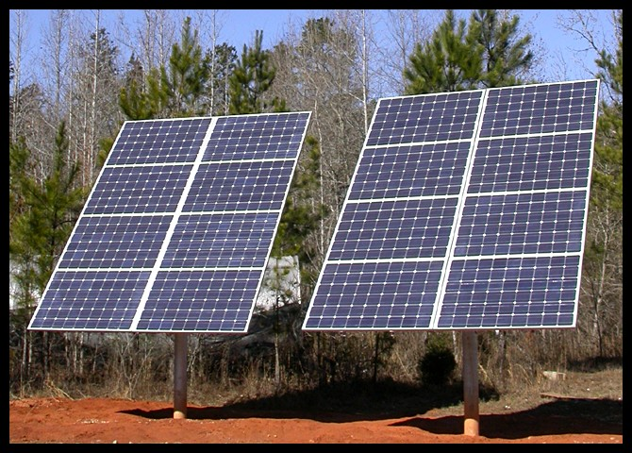
Solar array

Slide 20
Exercise Problems
1. Light Emitting Diodes (LED) is used in fancy electronic devices such as toys emit
A. X-rays B. Ultraviolet light C. visible light D. radio waves
2.The maximum wave length of photons that can be detected by a photo diode made of a semiconductor of band gap 2 eV is about…………………………
3. List the applications of opto-couplers.
4. What value of series resistor is required to limit the current through a LED to 20 mA with a forward voltage drop of 1.6 V when connected to a 10V supply? Given V_{D}=1.6 V.

